Slide 1
Mobile Application Development
Designing User Interface

Slide 2
Programming Methodologies for Mobile Applications
There are two main methods for designing user interface of a mobile application.
1. Declarative design method: involves writing code that specifies what should be done by the mobile device.
When using android platform to develop mobile applications,
eXtensible Markup Language (XML) is used to implement declarative programming.
2. Procedural design method: involves writing code that specifies how user interface objects will be created.
Android platform, Java programming language is used to implement procedural design.
This is done by writing Java code to create and manipulate all the user interface objects such as buttons,labels and text fields

Slide 3
Choice of Design Method
Android allows developers to create user interfaces in either style.
The user interface can be designed almost entirely using either Java code or XML descriptors.
There are Java APIs and the corresponding declarative XML attributes that do the same thing.
Which should you use? Either way is valid, but XML is recommended due to the following reasons:
1. XML code is require few lines of code (shorter) than corresponding java code
2. XML easier to understand than the corresponding Java code

Slide 4
Choice of Design Method
eXtensible Markup Language (XML)

Slide 5
eXtensible Markup Language (XML)
In android platform eXtensible Markup Language(XML) is used to describes what will be viewed by the user when the application is launched.
For example, push buttons, labels and text field.
It is also describes what information to be stored or transferred.
Data stored on an external XML file can be available to all kinds of mobile devices.

Slide 6
The Difference Between XML and HTML
XML was created to define, store, and transfer information while HTML was designed to display data, with focus on how data looks
HTML documents can only use tags defined in the HTML standard (like <p>, <h1>, etc.) while XML allows the author to define his/her own tags and his/her own document structure

Slide 7
Terminologies used in XML
There are several terminologies that are used when programming using XML. These are:
XML tag
XML element
XML attributes
XML Namespace

Slide 8
XML tags
A Tag is a construct for describing elements of a document.
A tag begins with opening angle bracket (‘<‘) and ends with closing angle bracket (‘ >’)
There are three types of tags
start-tags indicate the beginning of an element.
For example: <Text View>
end-tags indicates the end of an element
For example: </Text View>
empty-element tags; do not have end-tags and must be terminated by a ‘/’. For example: <Text View />
XML tags are not predefined. You must define your own tags

Slide 9
XML tags
XML tags Must be Properly Nested within each other
That is, the order of opening tags should be viceversa when
closing the same element
Example:
<Linear Layout> <TextView > ........</TextView></LinearLayout>
In the example above, "Properly nested" means that since the <TextView > element is opened inside the <Linear Layout> element, it must be closed inside the <Linear Layout> element.
Example2
  <name><email>…</name></email> is not allowed.
  <name><email>…</email></name> is allowed

Slide 10
What is an XML Element?
An XML element is A logical document component which either begins with a start-tag and ends with a matching end-tag or consists only of an empty-element tag .
The characters between the start- and end-tags, if any, are the element's content, and may contain markup, including other elements, which are called child elements
An element can contain:
other elements text
attributes
Both elements and attributes.

Slide 11
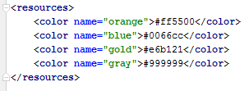
XML elements: Example
In the example above,
<resources> element contains <color> element

Slide 12
XML elements: Example
<color> element also has one attribute (name).
There are four values assigned to name :
“ orange”, “blue”, “ gold”, “gray
There are four text content:
#ff5500, #0066cc, #e6b121, #999999.

Slide 13
Empty XML Elements
An alternative syntax can be used for XML elements with no content:
Example
<resources> </resources>

Slide 14
XML Attributes
Attributes often provide information that is not a part of the
data.
In the example below, the file type is irrelevant to the data, but
can be important to the software that wants to manipulate the
element:
Example:
<file type="gif">computer.gif</file>

Slide 15
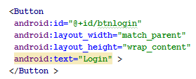
XML Elements vs. Attributes
In the example below:
Button element has three attributes (id, layout_width, layout_height and text).
Each attribute is initialized with a value
Example:

Slide 16
XML Attributes for Metadata
ID references are assigned to elements for identification purposes.
In the following example Button element is assigned an ID btnlogin

Slide 17
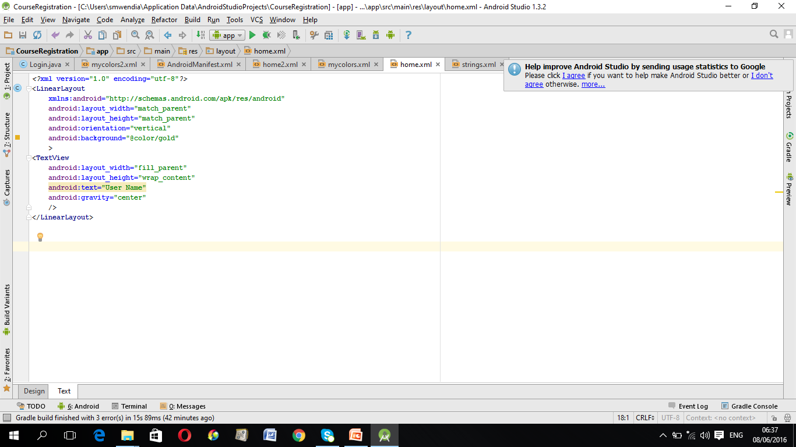
XML Namespaces (xmlns) Attribute
A Namespace is a set of unique names assigned to a group that is identified with one name.
It is a mechanisms by which element and attribute name can be assigned to group.
XML Namespaces provide a method to avoid element name conflicts.
The Namespace is identified by Uniform Resource Identifiers (URI).
Example:

Slide 18
XML Namespaces (xmlns) Attribute
A Namespace is declared using reserved attributes.
Such an attribute name must either be xmlns or begin with xmlns:
as follows:
    <element xmlns: name="URL">
The Namespace starts with the keyword xmlns.
The word name is the Namespace prefix.
The URL is the Namespace identifier.

Slide 19
XML Namespaces (xmlns) Attribute : Example
Here, the Namespace prefix is Android, and the Namespace identifier (URI) as http://schemas.android.com/apk/res/android.
This means, the element names and attribute names with the android prefix ,all belong to the http://schemas.android.com/apk/res/android namespace.

Slide 20
XML Namespaces (xmlns) Attribute
In the example above, the xmlns attribute in the <linear Layout> tag give the android a qualified namespace.
When a namespace is defined for an element, all child elements with the same prefix are associated with the same namespace.
The purpose is to give the namespace a unique name.
However, often companies use the namespace as a pointer to a web page containing namespace information.

Slide 21
Uniform Resource Identifier (URI)
A Uniform Resource Identifier (URI) is a string of characters which identifies an Internet Resource .
Such identification enables interaction with representations of the web resource over a network, typically the World Wide Web, using specific protocols.
An URI identifies a resource either by location, or a name, or both.
A URI has two specializations:
1. Uniform Resource Locator (URL)
2. Universal Resource Name (URN).

Slide 22
Uniform Resource Locator (URL)
Uniform Resource Locator (URL) is used to identify an Internet domain address.
It specifies where an identified resource is located and the protocol for retrieving it.
Examples of retrieving protocol are:
http://, ftp:// or smb://

Slide 23
Uniform Resource Name (URN)
An Uniform Resource Name (URN) is a Uniform Resource Identifier (URI) that uses he URN scheme, and defines the identity of a resource.
It does not imply availability of the identified resource.
A URN has to be of this form
"urn:" <NID> ":" <NSS>
where
<NID> is the Namespace Identifier,
<NSS> is the Namespace Specific String.

Slide 24
Uniform Resource Name (URN)
Example1:
urn:isbn:0451450523
In this example, a book is identified by its book number.
ISBN stands for International Standard Book Number.
It is a unique numeric commercial book identifier.
ISBN is assigned to each edition and variation
(except re- printings) of a book.
Example 2:
urn:issn:0167-6423
ISSN stands for International Standard Serial Number
It is an internationally accepted code which identifies the title of serial publications. e.g. Journal is identified by its serial number

Slide 25
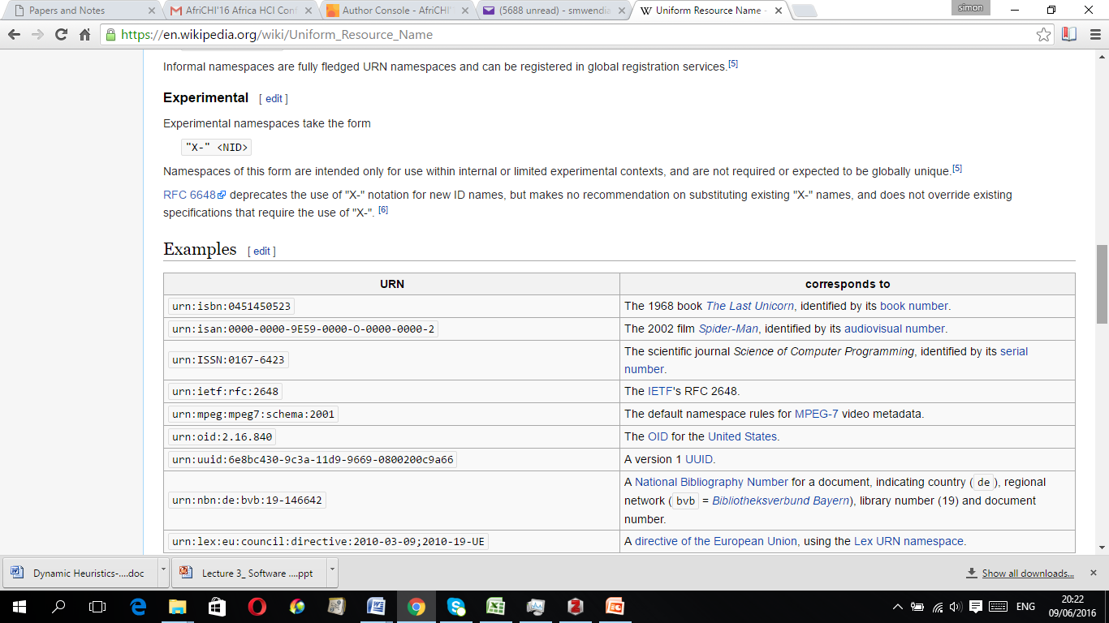
Uniform Resource Name (URN):
Other Examples

Slide 26
XML Document tree Structure
XML documents must contain a root element.
A document has a single root element
This element is "the parent" of all other elements.
The tree starts at the root and branches to the lowest level of the tree.
All elements can have sub elements (child elements):
<root>
<child>
<subchild>.....</subchild>
</child>
</root>

Slide 27
XML Document tree Structure
The terms parent, child, and sibling are used to describe the relationships between.
The terms parent, child, and sibling are used to describe the relationships between elements.
Parent elements have children. Children on the same level are called siblings (brothers or sisters).
All elements can have text content and attributes (just like in HTML).

Slide 28
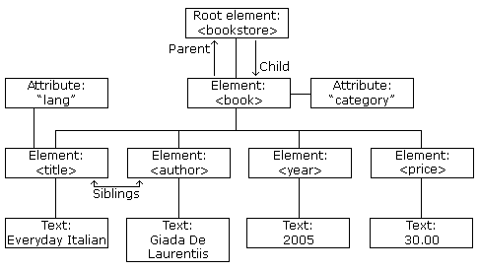
XML Document tree Structure example

Slide 29
XML Document tree Structure example
<bookstore>
<book category="COOKING">
<title lang="en">Everyday Italian</title>
<author>Giada De Laurentiis</author>
<year>2005</year>
<price>30.00</price>
</book>
</bookstore>

Slide 30
XML Document tree Structure example
In this example, the root element in the example is <bookstore>.
All <book> elements in the document are contained within <bookstore>.
The <book> element has 4 children:
<title>,< author>, <year>, <price>.

Slide 31
XML Syntax Rules
1. In XML, it is illegal to omit the closing tag.
All elements must have a closing tag:
Example
<Edit Text>..............</Edit Text>
<br />
Note: XML declaration did not have a closing tag since it is not a part of the XML document itself, and it has no closing tag.

Slide 32
XML Syntax Rules
2. XML Tags are Case Sensitive
Example: The tag <TextView> is different from the tag <textview>.
Opening and closing tags must be written with the same case:
Example:
<Button> This is correct </Button>
Note: "Opening and closing tags" are often referred to as "Start and end tags".

Slide 33
XML Syntax Rules
3. XML Documents Must Have a Root Element
XML documents must contain one element that is the parent of all other elements.
This element is called the root element.
Format:
    <root>
    <child>
    <subchild>.....</subchild>
    </child>
    </root>

Slide 34
XML Syntax Rules
4. XML Attribute Values Must be Quoted
XML elements can have attributes in name/value pairs just like in HTML.
In XML, the attribute values must always be quoted.
Example:

Slide 35
XML Syntax Rules
5. Comments in XML
Comments refers to statements that will be ignored by CPU
during execution.
The are used to help understanding of the code
The syntax for writing comments in XML is as follows:
<!-- This is a comment -->

Slide 36
XML Syntax Rules
6. White-space is Preserved in XML
This means that the white-space in a document is not truncated.
Example:
XML : User Name
Output: User Name

Slide 37
XML Naming Rules
XML elements must follow six naming rules:
  Names can contain letters, numbers, and other characters
  Names cannot start with a number or punctuation character
  Names cannot start with the letters xml (or XML, or Xml, etc)
  Names cannot contain spaces
  Any name can be used, no words are reserved.
  6. The name should be meaningful

Slide 38
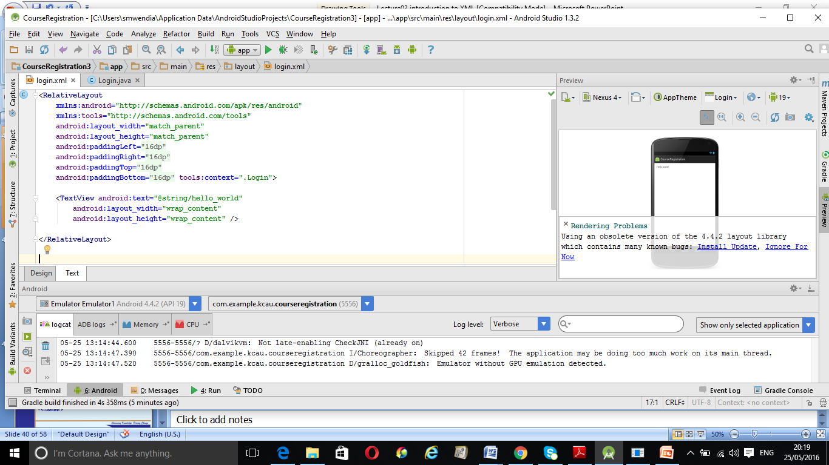
Exercise1
Consider the following login.xml File

Slide 39
Exercise1
Identify the following elements in the login.xml file:
Root element
Parent elements
Child elements
Attributes
XML Namespaces
Values

Slide 40
Exercise 2
Draw a tree structure that represents the following XML document
<?xml version="1.0"?>
<Company>
<Employee> <FirstName>Tanmay</FirstName>
<LastName>Patil</LastName>
<ContactNo>1234567890</ContactNo> <Email>tanmaypatil@xyz.com</Email>
<Address>
<City>Bangalore</City>
<State>Karnataka</State>
<Zip>560212</Zip>
</Address>
</Employee>
</Company>

Slide 41

End
Thank You
Questions

